Slide 1
Continuous Random Variables

Slide 2
Consider the following table of sales, divided into intervals of 1000 units each,
interval | f | Relative Frequency
(0,1000] | 10 | 10/150
(1000,2000] | 22 | 22/150
(2000,3000] | 30 | 30/150
(3000,4000] | 35 | 35/150
(4000,5000] | 20 | 20/150
(5000,6000] | 18 | 18/150
(6000,7000] | 15 | 15/150

Slide 3
and the relative frequency of each interval.
interval | relative freq.
(0,1000] | 0
(1000,2000] | 0.05
(2000,3000] | 0.25
(3000,4000] | 0.30
(4000,5000] | 0.25
(5000,6000] | 0.10
(6000,7000] | 0.05
 | 1.00

Slide 4
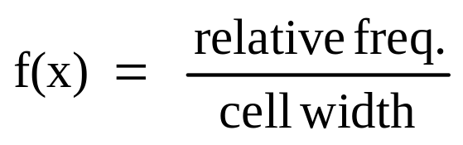
We’re going to divide the relative frequencies by the width of the cells (which here is 1000).
This will make the graph have an area of 1.
interval | relative freq.
(0,1000] | 0 | 0
(1000,2000] | 0.05 | 0.00005
(2000,3000] | 0.25 | 0.00025
(3000,4000] | 0.30 | 0.00030
(4000,5000] | 0.25 | 0.00025
(5000,6000] | 0.10 | 0.00010
(6000,7000] | 0.05 | 0.00005

Slide 5
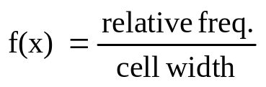
Histogram
f(x) = p(x)
0.00030
0.00025
0.00020
0.00015
0.00010
0.00005
0
interval
(0,1000] | 0
(1000,2000] | 0.00005
(2000,3000] | 0.00025
(3000,4000] | 0.00030
(4000,5000] | 0.00025
(5000,6000] | 0.00010
(6000,7000] | 0.00005
0 1000 2000 3000 4000 5000 6000 7000
sales
The area of each bar is the relative frequency of the category, so the total area is 1.

Slide 6
Frequency Polygon
f(x) = p(x)
0.00030
0.00025
0.00020
0.00015
0.00010
0.00005
0
interval
(0,1000] | 0
(1000,2000] | 0.00005
(2000,3000] | 0.00025
(3000,4000] | 0.00030
(4000,5000] | 0.00025
(5000,6000] | 0.00010
(6000,7000] | 0.00005
0 1000 2000 3000 4000 5000 6000 7000
sales
Here is the frequency polygon.

Slide 7
If we make the intervals 500 units instead of 1000, the graph would probably look something like this:
f(x) = p(x)
The height of the bars increases and decreases more gradually.
sales

Slide 8
If we made the intervals infinitesimally small, the bars and the frequency polygon would become smooth, looking something like this:
This what the distribution of a continuous random variable looks like.
This curve is denoted f(x) or p(x) and is called the probability density function.
f(x) = p(x)
sales

Slide 9
pmf versus pdf
For a discrete random variable, we had a probability mass function (pmf).
The pmf looked like a bunch of spikes, and probabilities were represented by the heights of the spikes.
For a continuous random variable, we have a probability density function (pdf).
The pdf looks like a curve, and probabilities are represented by areas under the curve.

Slide 10
Pr(a < X < b)
f(x) = p(x)
sales
a b

Slide 11
A continuous random variable has an infinite number of possible values & the probability of any one particular value is zero.
P(X=3)=0

Slide 12
If X is a continuous random variable, which of the following probabilities is largest?
(Hint: This is a trick question.)
1. Pr(a < X < b)
2. Pr(a ≤ X < b)
3. Pr(a < X ≤ b)
4. Pr(a ≤ X ≤ b)
They’re all equal.
They differ only in whether they include the individual values a and b, and any one particular value has zero probability!

Slide 13
Properties of probability density functions (pdfs)
1. f(x) ≥ 0 for values of x
This means that when we draw the pdf curve, while it may be on the left side of the vertical axis (have negative values of x), it can not go below the horizontal axis, where f would be negative.
Pr( - ∞ < X < ∞) = 1
The total area under the pdf curve, which corresponds to the total probability, is 1.

Slide 14
Example
f(x) = 2 if 1 ≤ x ≤ 1.5 and
f(x) = 0 otherwise
This function satisfies both the properties of pdfs.
First, it’s never negative.
Second, the total area under the curve is (1/2) (2) = 1.
f(x)
2.0
0 1.0 1.5 x

Slide 15
Cumulative Distribution Function for a Continuous Random Variable
F(x) = Pr(X ≤ x) = area under the f(x) curve up to where X=x.

Slide 16
Rectangle Example: What is F(1.2)?
F(1.2) = Pr(X ≤ 1.2)
= the area under the pdf up to where x is 1.2.
f(x)
2.0
0 1.0 1.5 x

Slide 17
Rectangle Example: What is F(1.2)?
F(1.2) = Pr(X ≤ 1.2)
= the area under the pdf up to where x is 1.2.
= (0.2) (2.0)
= 0.4
f(x)
2.0
0 1.0 1.2 1.5 x

Slide 18
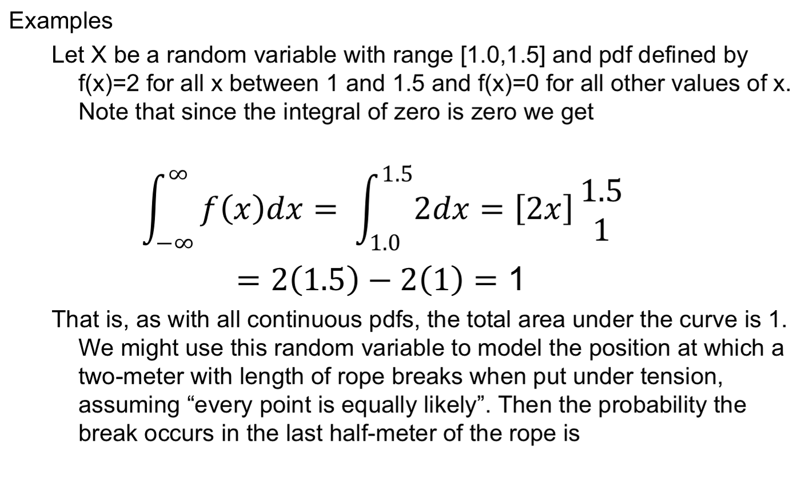
Definition and Basic Properties

Slide 19
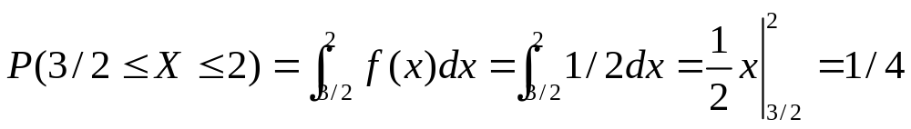

f(x)=1/2 for 0<x<2
P(2<x<3)

Slide 20
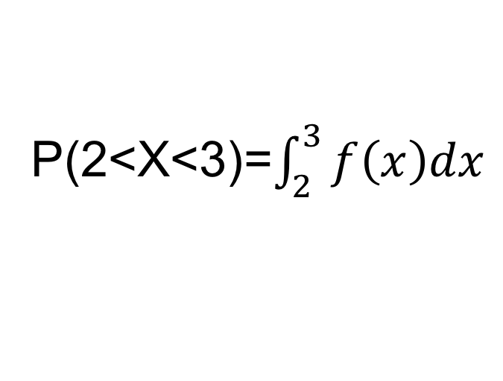
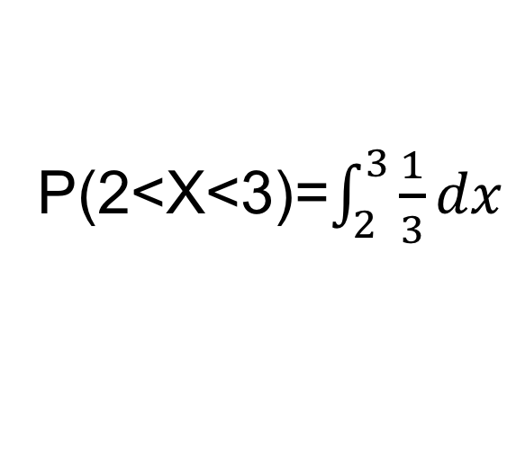
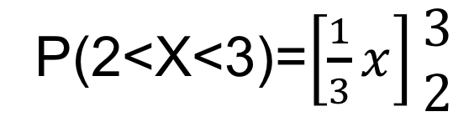
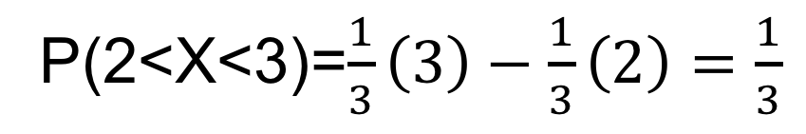

Slide 21
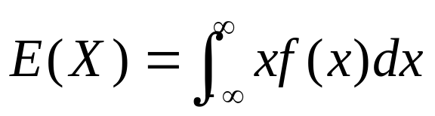

Expectation and Variance
Definitions
  The expected value of a continuous random variable X is defined by
  Note the similarity to the definition for discrete random variables. Once again we often denote it by . As in the discrete case this integral may not converge, in which case the expectation if X is undefined.
10/29/2003
Probability and Statistics for Teachers, Math 507, Lecture 9

Slide 22
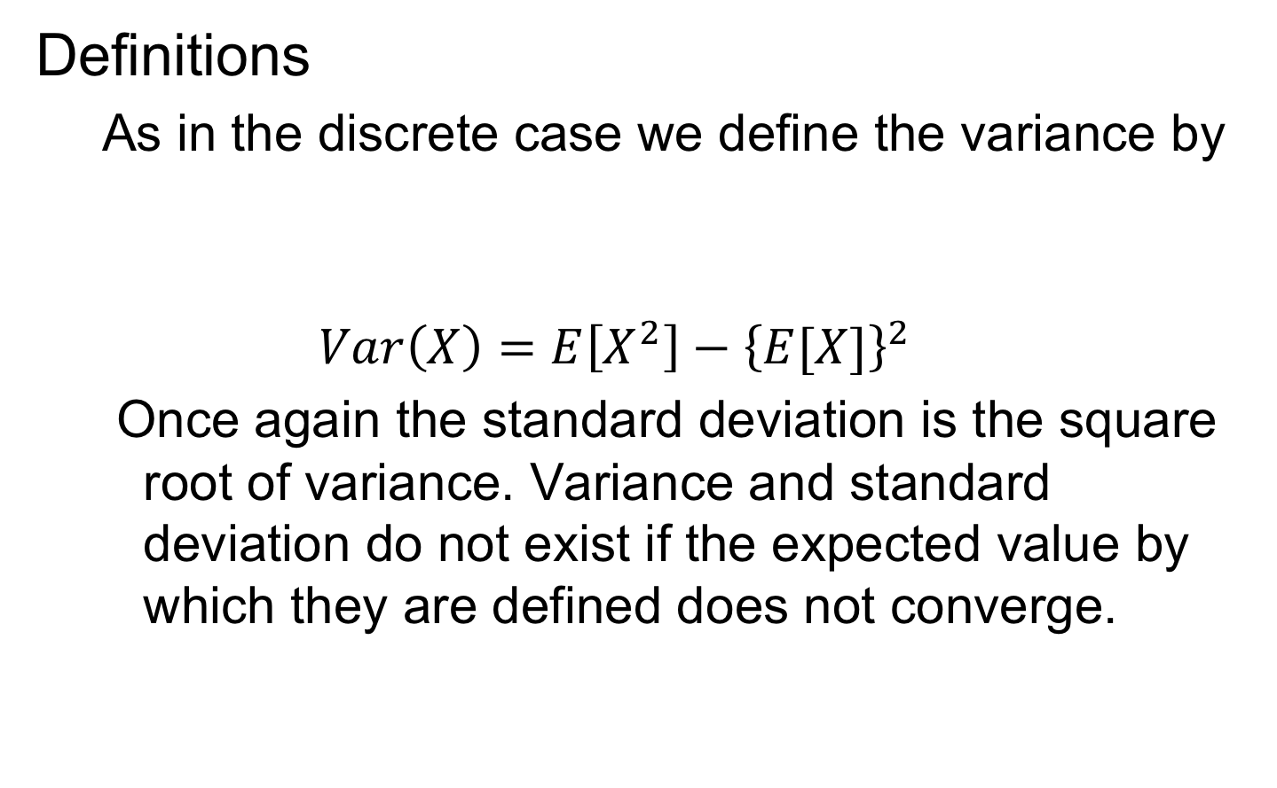
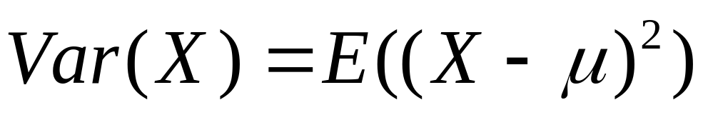
Expectation and Variance
10/29/2003
Probability and Statistics for Teachers, Math 507, Lecture 9

Slide 23
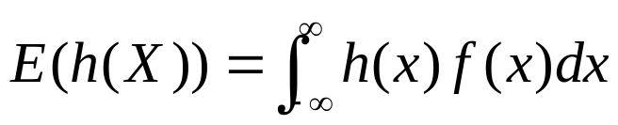
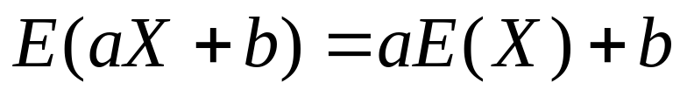
Expectation and Variance
Theorems
  The Law Of The Unconscious Statistician holds in the continuous case. Here it states
  Expected value still preserves linearity. That is
  The proof depends on the linearity of the definite integral (even an improper Riemann integral).
10/29/2003
Probability and Statistics for Teachers, Math 507, Lecture 9

Slide 24

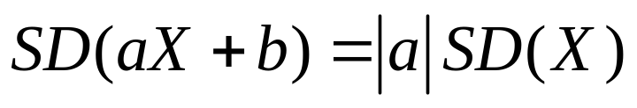
Expectation and Variance
Theorems
  Similarly the expected value of a sum of functions of X equals the sum of the expected values of those functions (see theorem 4.3 in the book) by the linearity of the definite integral.
  The shortcut formula for the variance holds for continuous random variables, depending only on the two preceding linearity results and a little algebra, just as in the discrete case. The formula states

Slide 25
Continuous Uniform Distributions.
Distributions like our rectangle example are called uniform distributions.
Notice that there are both discrete uniform distributions that we discussed earlier and continuous uniform distributions.

Slide 26
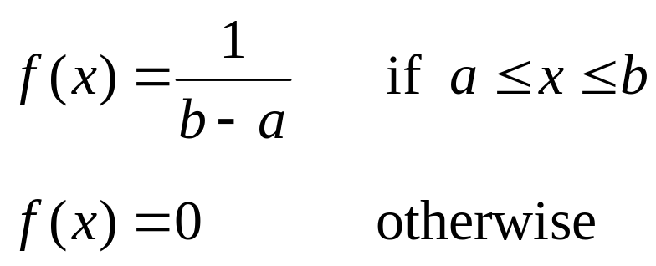

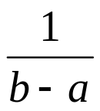
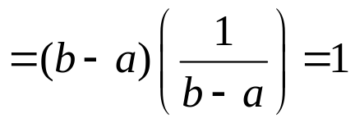
The continuous uniform distribution has the following form:
X~U(a,b)
Notice that the area of the rectangle will always be 1 because
area = length • width

Slide 27
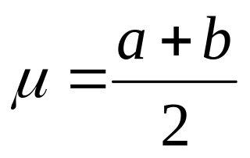
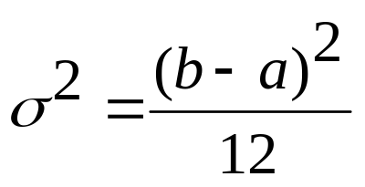
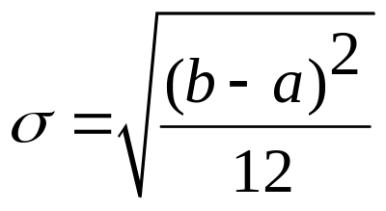
Mean, variance, and standard deviation of the continuous uniform distribution
mean:
variance:
standard deviation:

Slide 28
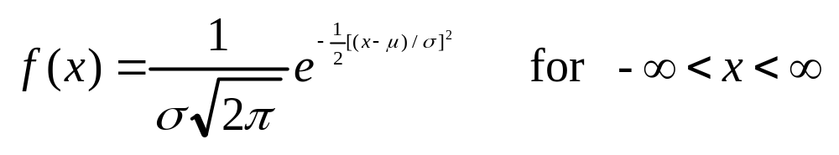

The most famous distribution is the Normal or Gaussian distribution.
Its probability density function (pdf) is
μ is the mean of the distribution, σ is the standard deviation,
It is sometimes denoted N (μ, σ²), which means the normal distribution with a mean of μ and a variance of σ².

Slide 29
If you have three normal distributions with the same standard deviation (same spread), but different means (different averages), they would look like this:
μ₁ μ₂ μ₃

Slide 30
If you had the same mean but different standard deviations, it would look like this:
large standard deviation

Slide 31
If you had the same mean but different standard deviations, it would look like this:
medium standard deviation
large standard deviation

Slide 32
If you had the same mean but different standard deviations, it would look like this:
small standard deviation
middle standard deviation
largest standard deviation
Keep in mind that the areas are all the same, since they all equal 1.

Slide 33
Recall that if a random variable has mean μ and standard deviation σ, then (X-μ)/σ has mean 0 and standard deviation 1.
If X is normally distributed, then (X-μ)/σ will be standard normal, N(0,1), normal with mean 0 and variance 1.
This theorem is extremely useful.
It means that we don’t need to use the messy normal formula.
We can standardize any normal distribution and look up probabilities in tables for the standard normal distribution.

Slide 34
Using the standard normal table is not difficult, but it takes practice to get accustomed to it.
The table in your textbook gives probabilities that the standard normal (often called Z) is less than a particular number, that is Pr(Z ≤ a).
Some tables are set up differently, so you need to notice how a table is computed when you use it.
For example, a book we used previously gave probabilities that Z is between zero and a positive number, that is, Pr(0 ≤ Z ≤ a).
Given any setup, you can always calculate the probabilities that you need.

Slide 35
Do not memorize a lot of rules.
You just need to remember 2 easy facts.
The graph is symmetric about 0.
The total area under the curve is 1.
0 Z

Slide 36
Example
Pr(Z < 1.85)
0 1.85 Z

Slide 37
Example
Pr(Z < 1.85) = 0.9678
0.9678
0 1.85 Z

Slide 38
Example
Pr(0 < Z < 1.85)
0.9678
0 1.85 Z

Slide 39
Example
Pr(0 < Z < 1.85) = 0.9678 – 0.5 = 0.4678
0.5
0.4678
0.9678
0 1.85 Z

Slide 40
Example
Pr(Z > 1.85)
0.9678
?
0 1.85 Z

Slide 41
Example
Pr(Z > 1.85) = 1 - 0.9678 = 0.0322
0.9678
0.0322
0 1.85 Z

Slide 42
Example
Pr(Z < -1.85)
There are two ways to do this.
0.9678
0.0322
-1.85 0 1.85 Z
Pr( Z < -1.85) = Pr(Z > 1.85) = 0.0322

Slide 43
Example
The second way to determine Pr(Z < -1.85)
is directly from the negative part of the Z table.
-1.85 0 Z
Pr( Z < -1.85) = 0.0322

Slide 44
Example
Pr(Z > -1.85)
-1.85 0 1.85 Z

Slide 45

Example
Pr(Z > -1.85) = Pr(Z < 1.85) = 0.9678
-1.85 0 1.85 Z

Slide 46

Example
Pr(-1< Z < 2)
-1.00 0 2.00 Z

Slide 47

Example
Pr(-1< Z < 2) = 0.9772 - 0.1587 = 0.8185
0.1587
0.9772
-1.00 0 2.00 Z

Slide 48
Example
Pr(1< Z < 2)
?
0 1 2 Z

Slide 49
Example
Pr(1< Z < 2) = 0.9772 - 0.8413 = 0.1359
0.8413
0.9772
0 1 2 Z

Slide 50
Example
Pr( Z < 7)
0 7 Z

Slide 51
Example
Pr( Z < 7) = 1.0000 (to 4 decimal places)
0 7 Z

Slide 52
Example
Pr( Z > 7)
0 7 Z

Slide 53
Example
Pr( Z > 7) = 0.0000 (to 4 decimal places)
0 7 Z

Slide 54
Example
Pr(0 < Z < 7)
0 7 Z

Slide 55
Example
Pr(0 < Z < 7) = 0.5000 (to 4 decimal places)
0 7 Z

Slide 56
Example
What is the value of a such that Pr(Z < a) = 0.9207 ?
0.9207
0 a Z

Slide 57
Example
What is the value of a such that Pr(Z < a) = 0.9207 ?
0.9207
0 1.41 Z

Slide 58
Example
What is the value of b such that Pr(Z > b) = 0.0250 ?
0.0250
0 b Z

Slide 59
Example
What is the value of b such that Pr(Z > b) = 0.0250 ?
1 – 0.0250 = 0.9750
0.0250
0 b Z

Slide 60
Example
What is the value of b such that Pr(Z > b) = 0.0250 ?
1 – 0.0250 = 0.9750
0.0250
0 1.96 Z

Slide 61
Example
What is the value of k such that Pr(0 < Z < k) = 0.4750 ?
0.4750
0.5 + 0.4750 = 0.9750
0 k Z

Slide 62
Example
What is the value of k such that Pr(0 < Z < k) = 0.4750 ?
0.4750
0.5 + 0.4750 = 0.9750
0 1.96 Z

Slide 63
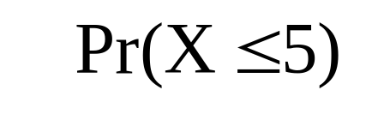
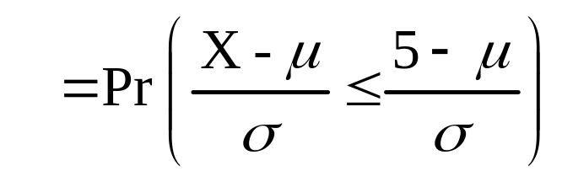
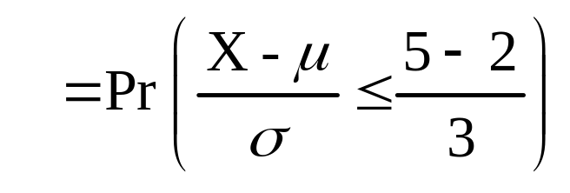
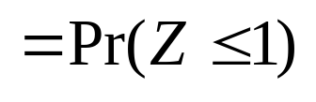

Example:
If X is N(2, 9), determine Pr(X ≤ 5).
0.8413
0 1.00 Z

Slide 64
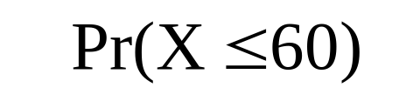
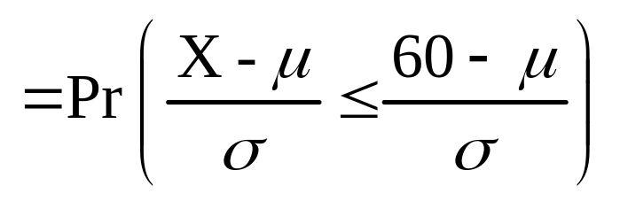
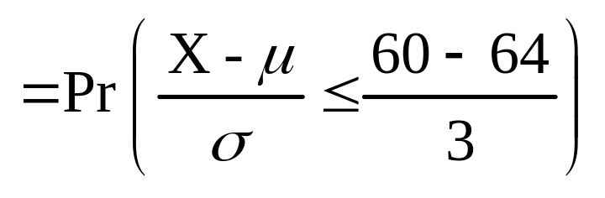
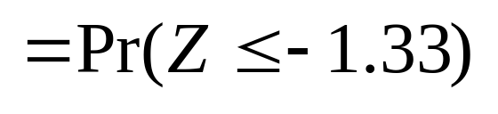
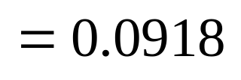
Example: Suppose that women’s heights are normally distributed with mean 64 inches & standard deviation 3 inches. What is the probability that a randomly selected woman is under five feet tall?
-1.33 0 Z

